Slide 1
Inclusive Language

Slide 2
Overview
What is inclusive language?
What is ableism?
Ableism at university
Using inclusive language
Useful resources

Slide 3
What is inclusive language
From UVIC:
“Inclusive communication that respects and includes all communities is free from sexist, racist and other discriminatory language. It does not inadvertently exclude groups and it avoids stereotypes, loaded words and patronizing descriptors.” [1]
Notes:
https://www.uvic.ca/brand/story/style/inclusivity/index.php
Section 5.5 on mental and physical disabilities

Slide 4
Inclusive Language and Disability
Often, language surrounding disability and disabled individuals is negative and harmful, relying on stereotypes and tropes.
This language stems from ableism.
Ableist language excludes and harms disabled students.

Slide 5
What is ableism?
According to Dolmage, ableism is that which
“positively values able-bodiedness…. Ableism renders disability as abject, invisible, disposable, less than human, while able-bodiedness is represented as at once ideal, normal, and the mean or default” [2, p7]
Ableism is such a powerful part of our culture that oftentimes we don’t even recognize it.

Slide 6
Why is ableism harmful?
Ableism dehumanizes and devalues the “world’s largest minority group” [3, p1] based upon a faulty notion of “normalcy”. It puts the onus on the disabled person to adjust to the environment and society.
A recent US survey [4] found that 27.6% of American adults (that’s over 67 million people) self-identify as disabled or having a disability.

Slide 7
Ableism at university
Barriers to
physical access
social access
financial access
educational access

Slide 8
Exercise: Is UVIC ableist?
In small groups, brainstorm the ways in which UVIC (buildings, coursework, etc) is ableist. Specifically, discuss
Where have you encountered barriers on campus?
What ableist assumptions are made about students attending UVIC? Attending ENGR 110?

Slide 9
How to combat ableism at UVIC
Be aware of unequal and inequitable access to UVIC services (the focus of your research essay and lab design project)
Use inclusive language at all times (and especially as you’re writing the research essay)

Slide 10
Identifying ableist, non-inclusive writing
Focuses on the disability, not the individual
Jane, who uses a wheelchair, finished watching The Expanse.
Makes value judgments
Poor Freya suffers from hearing loss.

Slide 11
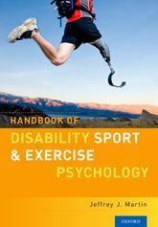
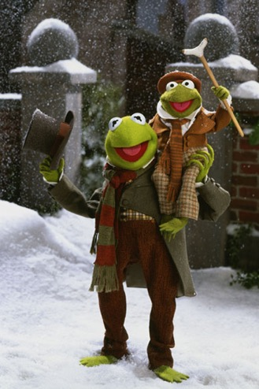
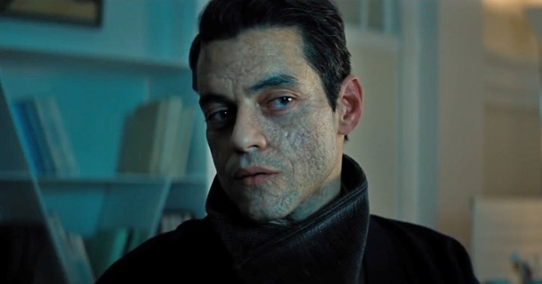
Uses the tropes of the “supercrip” or of the body indicating either malevolence or purity of mind/spirit.
Uses cliches/phrases/words that frame disability negatively
Blind leading the blind
That idea is lame/crazy
Notes:
The long tradition of Bond villains with facial differences: https://www.npr.org/2021/10/20/1047591067/from-scar-to-james-bond-enemy-safin-movie-villains-have-long-shared-a-harmful-tr
Tiny Tim’s goodness and purity as inversely reflected in his disability. The text uses him as a narrative prosthesis for Scrooge’s eventual redemption.

Slide 12
Exercise: Is this ableist?
In small groups, do the exercises in the “Inclusive Writing” document (found in our Brightspace).
Identify if the phrases are ableist or not. What’s your evidence?
We’ll go over your responses as a class.

Slide 13
Eliminating ableist writing
Just as you check for preferred pronouns, ask about a person’s preferred descriptor
Check the context to see if a person’s disability status if relevant
Be aware of the power of the gaze

Slide 14
Exercise: Revising ableist writing
In our same small groups, look over your answers in the “Inclusive Writing” document.
How would you correct these phrases to eliminate ableism?
We’ll go over your responses as a class.

Slide 15
Inclusive Language and the Research Essay
As you begin your research paper, keep the following in mind:
Acknowledge your own bias
Recognize ableist bias in others’ work (this includes articles written by academics!)
Take time to check a person’s preferred descriptor(s)
Avoid and eliminate ableist tropes

Slide 16
Recap
Ableism is pervasive
Ableism is a daily reality at UVIC
We can combat ableism through awareness and inclusive language use

Slide 17
Useful resources
Dolmage = ebook
McMaster & Kerschbaum = on reserve in the library!
J. Dolmage, Academic Ableism
C. McMaster and B. Whitburn, eds, Disability and the University
S. Kerschbaum, L. Eisenman, and J. Jones, Negotiating Disability: Disclosure and Higher Education
To understand the history of disability activism and current activism:
Crip Camp documentary (Netflix)
@Imani_Barbarin (Twitter) / @crutches_and_spice (TikTok)
Notes:
Dolmage ebook is accessible via UVIC library
McMaster and Whitburn’s text has short articles on a great variety of accessibility issues
Kerschbaum et al’s text has a great section on disclosure and institutional change that may be of use for the students

Slide 18
References
[1] “Section 5: Inclusive Language,” University of Victoria. [Online] https://www.uvic.ca/brand/story/style/inclusivity/index.php [Accessed 22 Oct 2021]
[2] J. Dolmage, Academic Ableism. Ann Arbor, MI: University of Michigan Press, 2017.
[3] S. Baglieri and P. Lalvani, Undoing Ableism: Teaching about disability in K-12 classrooms. Abingdon, United Kingdom: Routledge, 2020. [Online]. Available: https://doi-org.ezproxy.library.uvic.ca/10.4324/9781351002868
[4] V. Varadaraj, J. Deal, and J. Campanile, “National Prevalence of Disability and Disability Types Among Adults in the US, 2019,” in JAMA Netw Open vol. 4, no. 10 (2021). DOI: 10.1001/jamanetworkopen.2021.30358)

